Slide 1

Early Years
Emotional Wellbeing Practitioner (EWP) Programme
Day 2
Alison Crossick
Senior Educational Psychologist

Slide 2
Programme for Day 2
9.15am Welcome
Activity
9.40am Importance of Early Years
Activity
Understanding Attachments
11.00am Break
11.15am Observation Schedule
12.00pm Activity
13.00pm Lunch
13.45pm Analysis of Information from the observation
14.00pm Activity
14.30pm Building Resilience
Handout: Attachment book

Slide 3
Activity
In groups discuss:
Your ‘place in family’
Eldest/middle/youngest/only child
Your own first day at school
Notes:
Our experiences of being parented are unique (even in the same family)

Slide 4
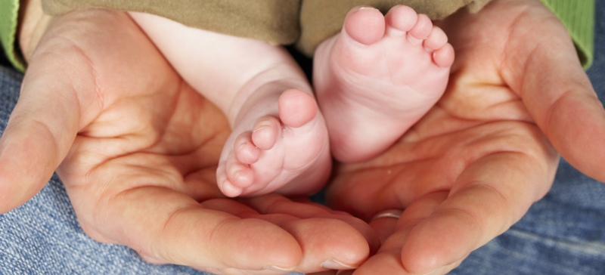
Importance of Early Years Experience
Year 1 brain doubles in size
Between 0-2 years is a critical time for emotional growth
By 3 years there is a dense network of neurons
Experience triggers the electrical activity
The brain is experience-dependent
A child living in fear has an altered brain chemistry
Observing Children with attachment Difficulties in Preschool Settings (p.16)

Slide 5

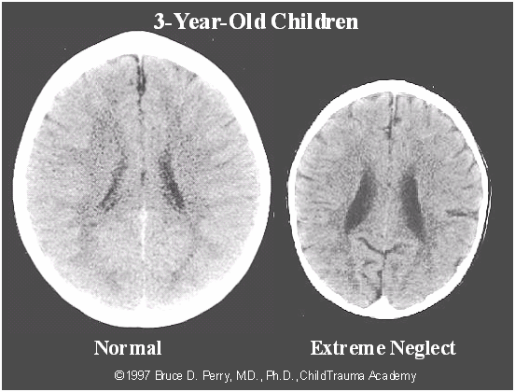
E D U C A T I O N A L P S Y C H O L O G Y S E R V I C E
Impact of neglect on the developing brain of a 3 yr old
The CT scan on the left shows an average developing brain. The scan on the right is from a 3 year old suffering extreme
global neglect.
From: Child Welfare Information Gateway
Notes:
It is smaller than average and abnormal development of cortical, limbic and midbrain structures.
such as those children from Romanian orphanages
Understanding the Effects of Maltreatment on Brain Development
Author's): Child Welfare Information Gateway Year Published: 2009
Effects of Maltreatment on Brain Development
Babies' brains grow and develop as they interact with their environment and learn how to function within it. When babies' cries bring food or comfort, they are strengthening the neuronal pathways that help them learn how to get their needs met, both physically and emotionally. But babies who do not get responses to their cries, and babies whose cries are met with abuse, learn different lessons. The neuronal pathways that are developed and strengthened under negative conditions prepare children to cope in that negative environment, and their ability to respond to nurturing and kindness may be impaired (Shonkoff & Phillips, 2000).
Brief periods of moderate, predictable stress are not problematic; in fact, they prepare a child to cope with the general world. The body's survival actually depends upon the ability to mount a response to stress (Shonkoff & Phillips, 2000). Children learn to deal with moderate stress in the context of positive relationships with reliable adult caregivers. Greater amounts of stress may also be tolerable if a child has a reliable adult who can help to buffer the child. But prolonged, severe, or unpredictable stress—including abuse and neglect—during a child's early years is problematic. In fact, the brain's development can literally be altered by this type of toxic stress, resulting in negative impacts on the child's physical, cognitive, emotional, and social growth.
The specific effects of maltreatment may depend on such factors as the age of the baby or child at the time of the abuse or neglect, whether the maltreatment was a one-time incident or chronic, the identity of the abuser (e.g., parent or other adult), whether the child had a dependable nurturing individual in his or her life, the type and severity of the abuse, the intervention, and how long the maltreatment lasted.
The sections below give a brief description of abuse and neglect and are followed by descriptions of some of the consequences of maltreatment.
Abuse—Physical, Sexual, and Emotional
Neglect—Lack of Stimulation
Global Neglect
Emotional and Behavioral Impact
Impact of Abuse and Neglect on Adolescents
Long-Term Effects of Abuse and Neglect
(Back to Top)
Abuse—Physical, Sexual, and Emotional
Abuse can refer to physical abuse, such as hitting, shaking, burning, or other forms of maltreatment that a parent or other caregiver might inflict. Sexual abuse is a subset of abuse that refers to any type of sexual behavior with a minor, while emotional abuse generally refers to any injury to a child's psychological or emotional stability (Child Welfare Information Gateway, 2008). Chronic stress may also qualify as emotional abuse. In some States, alcohol or substance abuse or domestic violence that affects the unborn child is considered child abuse.
Physical abuse can cause direct damage to a baby's or child's developing brain. For instance, we now have extensive evidence of the damage that shaking a baby can cause. According to the National Center on Shaken Baby Syndrome (2009), shaking can destroy brain tissue and tear blood vessels. In the short-term, shaking can lead to seizures, loss of consciousness, or even death. In the long-term, shaking can damage the fragile brain so that a child develops a range of sensory impairments, as well as cognitive, learning, and behavioral disabilities.
Babies and children who suffer abuse may also experience trauma that is unrelated to direct physical damage. Exposure to domestic violence, disaster, or other traumatic events can have long-lasting effects. An enormous body of research now exists that provides evidence for the long-term damage of physical, sexual, and emotional abuse on babies and children. We know that children who experience the stress of abuse will focus their brains' resources on survival and responding to threats in their environment. This chronic stimulation of the brain's fear response means that the regions of the brain involved in this response are frequently activated (Perry, 2001a). Other regions of the brain, such as those involved in complex thought and abstract cognition, are less frequently activated, and the child becomes less competent at processing this type of information.
One way that early maltreatment experiences may alter a child's ability to interact positively with others is by altering brain neurochemical balance. Research on children who suffered early emotional abuse or severe deprivation indicates that such maltreatment may permanently alter the brain's ability to use serotonin, which helps produce feelings of well-being and emotional stability (Healy, 2004).
Altered brain development in children who have been maltreated may be the result of their brains adapting to their negative environment. If a child lives in a threatening, chaotic world, the child's brain may be hyperalert for danger because survival may depend on it. But if this environment persists, and the child's brain is focused on developing and strengthening its strategies for survival, other strategies may not develop as fully. The result may be a child who has difficulty functioning when presented with a world of kindness, nurturing, and stimulation.
(Back to Top)
Neglect—Lack of Stimulation
While chronic abuse and neglect can result in sensitized fear response patterns, neglect alone also can result in other problems. Malnutrition is a classic example of neglect. Malnutrition, both before and during the first few years after birth, can result in stunted brain growth and slower passage of electrical signals in the brain (Shonkoff & Phillips, 2000). This is due, in part, to the negative effect of malnutrition on the myelination process in the developing brain (ZERO TO THREE, 2009). The most common form of malnutrition in the United States, iron deficiency, can affect the growing brain and result in cognitive and motor delays, anxiety, depression, social problems, and attention problems (Shonkoff & Phillips, 2000).
Although neglect often is thought of as a failure to meet a child's physical needs for food, shelter, and safety, neglect also can be a failure to meet a child's cognitive, emotional, or social needs. For children to master developmental tasks in these areas, they need opportunities, encouragement, and acknowledgment from their caregivers. If this stimulation is lacking during children's early years, the weak neuronal pathways that had been developed in expectation of these experiences may wither and die, and the children may not achieve the usual developmental milestones.
For example, babies need to experience face-to-face baby talk and hear countless repetitions of sounds in order to build the brain circuitry that will enable them to start making sounds and eventually say words. If babies' sounds are ignored repeatedly when they begin to babble at around 6 months, their language may be delayed. In fact, neglected children often do not show the rapid growth that normally occurs in language development at 18-24 months (Scannapieco, 2008). These types of delays may extend to all types of normal development for neglected children, including their cognitive-behavioral, socio-emotional, and physical development (Scannapieco, 2008).
(Back to Top)
Global Neglect
Researchers use the term "global neglect" to refer to deprivations in more than one domain, i.e., language, touch, and interaction with others. Children who were adopted from Romanian orphanages in the early 1990s were often considered to be globally neglected; they had little contact with caregivers and little to no stimulation from their environment—little of anything required for healthy development. One study found that these children had significantly smaller brains than the norm, suggesting decreased brain growth (Perry, 2002). (See Exhibit 2.)
Exhibit 2
"These images illustrate the negative impact of neglect on the developing brain. In the CT scan on the left is an image from a healthy 3-year-old with an average head size. The image on the right is from a 3-year-old suffering from severe sensory-deprivation neglect. This child's brain is significantly smaller than average and has abnormal development of cortex." These images are from studies conducted by a team of researchers from the Child Trauma Academy led by Bruce D. Perry, M.D., Ph.D. (Reprinted with permission.)
This type of severe, global neglect can have devastating consequences. The extreme lack of stimulation may result in fewer neuronal pathways available for learning. The lack of opportunity to form an attachment with a nurturing caregiver during infancy may mean that some of these children will always have difficulties forming meaningful relationships with others (Perry, 2001a). But these studies also found that time played a factor—children who were adopted as young infants have shown more recovery than children who were adopted as toddlers (Rutter, et al., 2000).
(Back to Top)
Emotional and Behavioral Impact
New brain imaging technologies, research with animals, and studies of human growth in optimal and deprived conditions (such as institutions) continue to shed light on the impact of abuse and neglect on brain development. The sections below describe some of the major effects.
Persistent Fear Response. Chronic stress or repeated traumas can result in a number of biological reactions, including a persistent fear state (Perry, 2006). Neurochemical systems are affected, which can cause a cascade of changes in attention, impulse control, sleep, and fine motor control (Perry, 2000a; 2000b). Chronic activation of certain parts of the brain involved in the fear response (such as the hypothalamic-pituitary-adrenal [HPA] axis) can "wear out" other parts of the brain such as the hippocampus, which is involved in cognition and memory (Perry, 2000b). The HPA axis may react to chronic fear or stress by producing excess cortisol—a hormone that may damage or destroy neurons in critical brain areas (Putnam, 2006). Chronic activation of the neuronal pathways involved in the fear response can create permanent memories that shape the child's perception of and response to the environment. While this adaptation may be necessary for survival in a hostile world, it can become a way of life that is difficult to change, even if the environment improves.
Hyperarousal. When children are exposed to chronic, traumatic stress, their brains sensitize the pathways for the fear response and create memories that automatically trigger that response without conscious thought. This is called hyperarousal. These children have an altered baseline for arousal, and they tend to overreact to triggers that other children find nonthreatening (Child Trauma Academy, n.d.). These children may be highly sensitive to nonverbal cues, such as eye contact or a touch on the arm, and they may read these actions as threats. Consumed with a need to monitor nonverbal cues for threats, their brains are less able to interpret and respond to verbal cues, even when they are in a supposedly nonthreatening environment, like a classroom. While these children are often labeled as learning disabled, the reality is that their brains have developed so that they are constantly alert and are unable to achieve the relative calm necessary for learning (Child Trauma Academy, n.d.).
Dissociation. Infants or children who are the victims of repeated abuse may respond to that abuse—and later in life to other unpleasantness—by mentally and emotionally removing themselves from the situation. This coping mechanism of dissociation allows the child to pretend that what is happening is not real. Children who "zone out" or often seem overly detached may be experiencing dissociation. In some cases, it may be a form of self-hypnosis (Stien & Kendall, 2004). Dissociation is characterized by first attempting to bring caretakers to help, and if this is unsuccessful, becoming motionless (freezing) and compliant and, eventually, dissociating. Dissociation may be a reaction to childhood sexual abuse, as well as other kinds of active, physical abuse or trauma. Children who suffer from dissociation may retreat to the dissociative state when they encounter other stresses later in life.
This type of response may have implications for the child's memory creation and retention. The brain may use dissociation to smother the memories of a parent's abuse in order to preserve an attachment to the parent, resulting in amnesia for the abuse (Stien & Kendall, 2004). However, the implicit memories of the abuse remain, and the child may experience them in response to triggers or as flashbacks or nightmares. In its most extreme form, the child may develop multiple personalities, known as dissociative identity disorder.
Disrupted Attachment Process. At the foundation of much of our development is the concept of attachment, which refers to the emotional relationships we have with other people. An infant's early attachment to his or her primary caregiver provides the foundation for future emotional relationships. It also provides the base for other learning, because babies and children learn best when they feel safe, calm, protected, and nurtured by their caregivers. If the attachment process is disrupted or never allowed to develop in a healthy manner, as can occur with abusive and neglectful caretakers, the child's brain will be more focused on meeting the child's day-to-day needs for survival rather than building the foundation for future growth (Applegate & Shapiro, 2005).
Disrupted attachment may lead to impairments in three major areas for the developing child (Cook et al., 2005):
Increased susceptibility to stress
Excessive help-seeking and dependency or excessive social isolation
Inability to regulate emotions
Young infants depend on positive interactions with caregivers to begin to develop appropriate emotional control and response (affect regulation) (Applegate & Shapiro, 2005). For instance, lots of appropriate face-to-face and other contact helps infants recognize and respond to emotional cues. Infants whose caregivers are neglectful or abusive may experience affect dysregulation—meaning that these children are not able to identify and respond appropriately to emotional cues (Applegate & Shapiro, 2005). Ongoing maltreatment may result in insecure or anxious attachment because the child is not able to derive a feeling of security and consistency from the caregiver. Children who have experienced insecure or anxious attachments may have more difficulties regulating their emotions and showing empathy for others' feelings (Applegate & Shapiro, 2005). These children may have difficulties forming attachments later in life as well.
(Back to Top)
Impact of Abuse and Neglect on Adolescents
Adolescents who are abused or neglected were often maltreated at younger ages, as well. It can be difficult to isolate the effects of abuse and neglect during the adolescent years, because these youth often suffer from the cumulative effects of a lifetime of abuse and neglect.
Most teenagers who have not been victims of abuse or neglect find their teenage years to be exciting and challenging. Normal puberty and adolescence lead to the maturation of a physical body, but the brain lags behind in development, especially in the areas that allow teenagers to reason and think logically. Most teenagers act impulsively at times, using a lower area of their brain—their "gut reaction"—because their frontal lobe is not yet mature. Impulsive behavior, poor decisions, and increased risk-taking are all part of the normal teenage experience.
For teens who have been abused, neglected, or traumatized, this impulsive behavior may be even more apparent. Often, these youth have developed brains that focus on survival, at the expense of the more advanced thinking that happens in the brain's cortex (Chamberlain, 2009). An underdeveloped cortex can lead to increased impulsive behavior, as well as difficulties with tasks that require higher-level thinking and feeling. These teens may show delays in school and in social skills as well (Chamberlain, 2009). They may be more drawn to taking risks, and they may have more opportunity to experiment with drugs and crime if they live in environments that put them at increased risk for these behaviors. Teenagers who lack stable relationships with caring adults who can provide guidance and model appropriate behavior may never have the opportunity to develop the relationship skills necessary for healthy adult relationships or for becoming good parents.
(Back to Top)
Long-Term Effects of Abuse and Neglect
Maltreatment during infancy and early childhood can have enduring repercussions into adolescence and adulthood. As mentioned earlier, the experiences of infancy and early childhood provide the organizing framework for the expression of children's intelligence, emotions, and personalities. When those experiences are primarily negative, children may develop emotional, behavioral, and learning problems that persist throughout their lifetime, especially in the absence of targeted interventions. The Adverse Childhood Experiences (ACE) study is a large-scale, long-term study that has documented the link between childhood abuse and neglect and later adverse experiences, such as physical and mental illness and high-risk behaviors (Centers for Disease Control and Prevention, n.d.).
Some of the specific long-term effects of abuse and neglect on the developing brain can include (Teicher, 2000):
Diminished growth in the left hemisphere, which may increase the risk for depression
Irritability in the limbic system, setting the stage for the emergence of panic disorder and posttraumatic stress disorder
Smaller growth in the hippocampus and limbic abnormalities, which can increase the risk for dissociative disorders and memory impairments
Impairment in the connection between the two brain hemispheres, which has been linked to symptoms of attention-deficit/hyperactivity disorder
(Back to Top)
previous You are in section: next
This material may be freely reproduced and distributed. However, when doing so, please credit Child Welfare Information Gateway

Slide 6
Activity
Early Years setting is the first formal setting outside of home where children have to build new relationships
Children use early attachment experiences to build up a template of how relationships work, what to expect from others and what to believe about ourselves
p.77 – Read the summary and in groups discuss
how we can meet these needs

Slide 7
E D U C A T I O N A L P S Y C H O L O G Y S E R V I C E
Understanding
and
Building Attachment

Slide 8
The story of the 3 mice
E D U C A T I O N A L P S Y C H O L O G Y S E R V I C E
First mouse – Each time he pressed the button a tasty morsel of food was delivered.
Second mouse – Faulty button delivered food inconsistently.
Third mouse – Button didn’t work at all.
From:Pearce (2009)

Slide 9
Maslow’s hierarchy
E D U C A T I O N A L P S Y C H O L O G Y S E R V I C E
5 fulfilment needs
Higher level needs
4 esteem needs
3 social needs
2 safety needs
Basic needs
1 physiological needs

Slide 10
The continuing story…
E D U C A T I O N A L P S Y C H O L O G Y S E R V I C E
First mouse – Each time he needed comforting his parent or surrogate mouse parent was there for him.
Second mouse – Sometimes his parent or surrogate mouse responded with love and was empathic to his needs, but it varied from day to day.
Third mouse – No-one was emotionally available to him.

Slide 11
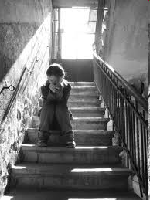
E D U C A T I O N A L P S Y C H O L O G Y S E R V I C E
Sometimes looking sad is met with friendly concern, and sometimes you are berated and punished. But you just never know…..
(Cameron, 1978)

Slide 12
What is attachment?
E D U C A T I O N A L P S Y C H O L O G Y S E R V I C E
It is described as the dependency relationship a child develops towards his or her primary caregiver.
A deep, loving human relationship in early life is at the very core of self-esteem.

Slide 13
Why is it important?
E D U C A T I O N A L P S Y C H O L O G Y S E R V I C E
It is thought that the success or failure of early attachments affect young children’s beliefs & expectations about relationships.
This representation of relationships influences the way children interact with others & evaluate themselves.

Slide 14
Secure & insecure attachments
E D U C A T I O N A L P S Y C H O L O G Y S E R V I C E
Securely attached children
Generally view the world as a safe place
View other people as a source of nurture & support
View themselves as worthy of attention
When they encounter difficulties, more likely to seek help
Insecurely attached children
Often view the world as unpredictable and threatening
View other people as harsh, unavailable or insensitive
View themselves as unworthy of being nurtured
When they encounter difficulties more likely to become frustrated, angry & give up

Slide 15
Disorganised attachment
E D U C A T I O N A L P S Y C H O L O G Y S E R V I C E
When a young child feels:
physically or psychologically unsafe
abandoned
vulnerable

Slide 16
E D U C A T I O N A L P S Y C H O L O G Y S E R V I C E
Self Regulation

Slide 17

E D U C A T I O N A L P S Y C H O L O G Y S E R V I C E
Attachment as a Regulatory system
Emotion
Regulation
Behaviour
Cognition

Slide 18
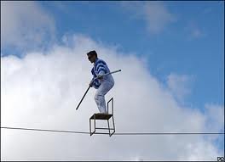
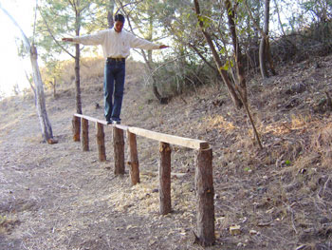
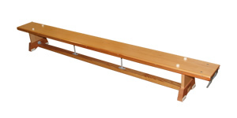
Over arousal in attachment-disordered children
E D U C A T I O N A L P S Y C H O L O G Y S E R V I C E

Slide 19
E D U C A T I O N A L P S Y C H O L O G Y S E R V I C E
Observation Schedule

Slide 20
Observation Checklist
Complete observation checklist
Analyse and build profile of emotional needs
Select targets and develop an action plan
Implement action plan and review progress
Collect contextual information

Slide 21
Observation Schedule
Purpose - What it is… What it isn’t…
When to use it
Who can complete it
Time scale
Contextual information
Frequency & intensity of behaviour

Slide 22
Observation Schedule
Behaviour
Play & relationship with peers
Attachment behaviours
Emotional state
Attitude to attending Early Years setting

Slide 23
Activity – Emily’s Observation
Read through the worked example of the observation checklist on page 46 and discuss what this tells us about Emily

Slide 24
Analysis of Information
Note the pattern of ticks
R – insecure avoidant style & strategies
L – Insecure ambivalent style
Mainly centre, focus on the individual difficulties
Work from the outside to the centre
Look at behaviours/triggers
Try and answer the 4 questions p.61

Slide 25
Action Plan for Emily
In groups discuss the completed Observation Schedule and analysis and have a go at completing the Action Plan for Emily

Slide 26
Concept of Resilience
The concept of resilience dates back to the Second World War when clinicians noted that some evacuated children appeared to suffer more psychological damage than those who stayed at home to face the bombing.
The concept has evolved over 50 years, and now informs and influences economics and politics at the highest levels.

Slide 27

Definition
Resilience is understood internationally
as having the capacity to resist or
‘bounce back’ following adversity.
It is generally considered to be made up of:
individual
family
community factors.

Slide 28
Trauma & Loss
Childhood trauma has both physiological & psychological effects.
Trauma does not generally get better by itself and can burrow further under the child’s defences & coping strategies.
Traumatised children often feel helpless, confused and afraid to trust.

Slide 29
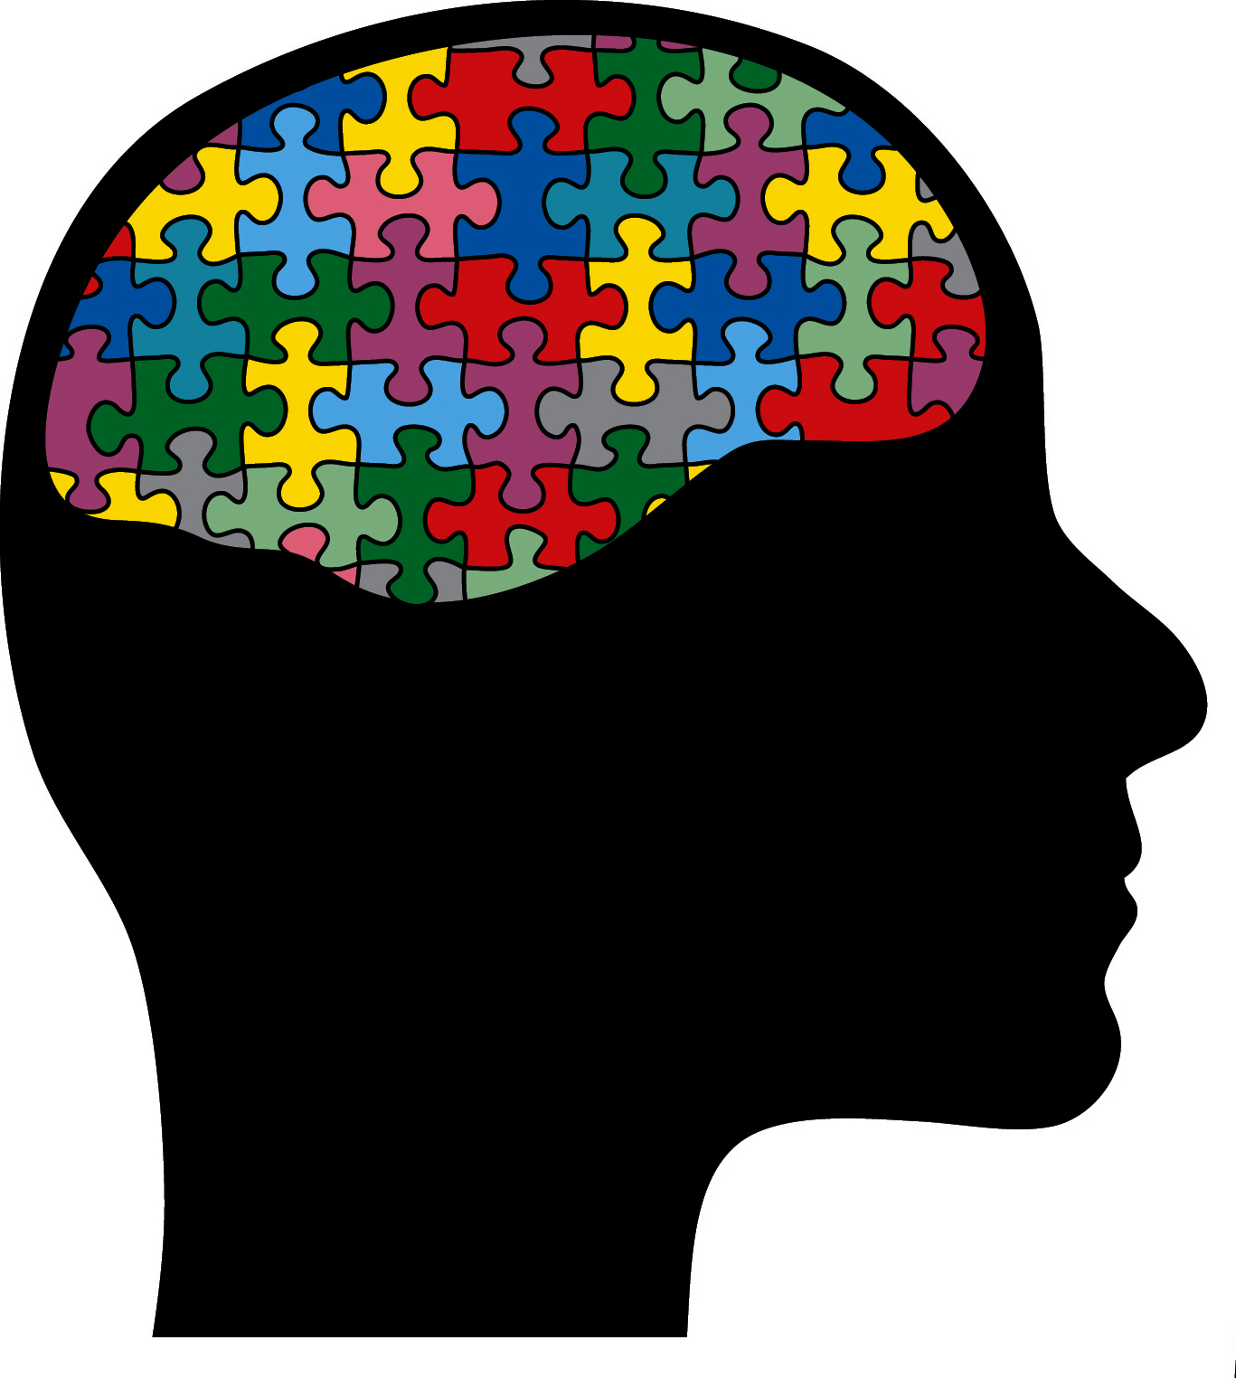
Brain wave
Resilience
is a skill,
it is our drive
to survive,
but also
to strive.
Our brain shapes us, but we also shape our brain.
Neuroplasticity is the brain’s ability to change throughout our life in response to experience.
We need to stimulate and strengthen the brain.
We have more connections in the brain than there are stars in the galaxy….

Slide 30

Building Blocks for Resilience
The internal factors are:
a secure base – the child feels a sense of belonging and security
a sense of self-efficacy – a belief in one’s own ability to complete tasks and reach goals, and recover quickly from setbacks
self-esteem – an internal sense of worth and competence.

Slide 31
Self concept
Ideal self
The bigger the gap between self-image and ideal-self, the lower the self-esteem
SELF ESTEEM
Self image

Slide 32
Building Blocks for Resilience
The external factors are:
at least one secure attachment relationship,
access to wider supports such as extended family and friends,
positive nursery, school and/or community experiences.

Slide 33
Promoting resilience in the home environment
The presence of at least one unconditionally supportive parent or reliable adult.
Maintenance of family routines and rituals.
Manageable contributions to the household that promote competencies, self-esteem and problem-solving.

Slide 34

Never assume you know what a young child is feeling…..
E D U C A T I O N A L P S Y C H O L O G Y S E R V I C E
Notes:
34

Slide 35
E D U C A T I O N A L P S Y C H O L O G Y S E R V I C E
What can we do?
Playfulness – A lighthearted relaxed & playful attitude to help the child experience fun & love.
Acceptance – Accepting the child’s behavioural choices and his/her feelings. Show your understanding and help the child with the consequences of these choices.
Curiosity – Wonder together with the child the meaning behind their behaviour. This can mean making a ‘best guess’.
Empathy – Convey acceptance of the inner child.
Dan Hughes
PACE

Slide 36
Thank you
Please do not use or copy any slides without prior permission from RBWM EPS

